Slide 1

Perspective Services in Post-NGN, 4G and 5G
Kiev, Ukraine, 7-9 June 2017
ITU-D Telecommunication Network and Spectrum Management Division (TND)
June 2016
Notes:
The Telecommunication Technology and Spectrum Management Division is responsible for managing programmes and projects for the development of Informationand Communicaiton Infrastructure.
The Activities covers different aspects

Slide 2



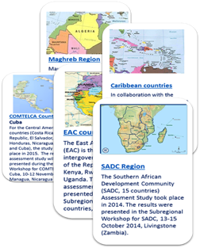
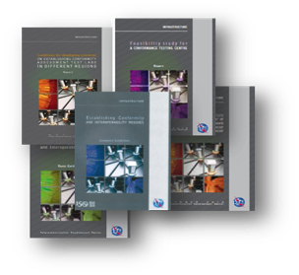

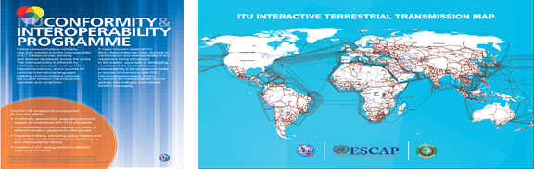
Telecommunication Technologies and Network Development
Our work is carried out by various means, including symposia, workshops, conferences, seminars and expert advice as well as information sharing, creation of tools and training material, direct assistance, partnership, publications and events. Our priority areas are as follows:
Next Generation
Networks
Mobile
Communications
Conformity and Interoperability
Broadband Networks
Rural Communications
Next-Generation Networks: assistance on planning, deployment, migration, interoperatbility, digitization and evolution of networks, network elements and applications
Broadband Networks (wired and wireless technologies): assitance with planning, implementation and development of national ICT broadband networks, including promoting IXPs
Rural communications: provision of information on access and backhaul technologies and source of power supply, latest technologies and best practice, implementation of projects on public community broadband access points
Conformance and interoperability (C&I): assistance on the establishment of national, regional or subregional C&I programmes, assessment and feasibility studies, providing information and training to technicians, policy-makers and businesses on C&I, providing guidelines on C&I
ITU Broadband, IPv6 and Internet Exchange Implementations: to provide broadband connectivity free or low cost digital access for schools, hospitals, underserved populations; IXPs to reduce transmission costs, optimize Internet traffic, improve QoS
ITU Interactive Transmission Maps: cutting-edge ICT-data mapping platform to take stock of national backbone connectivity and other key ICT metrics.
Bridging the Standardization Gap: Increasing the knowledge and capacity of developing countries for the effective application/implementation of standards
For more information please visit: http://www.itu.int/en/ITU-D/Technology/Pages/default.aspx

Slide 3
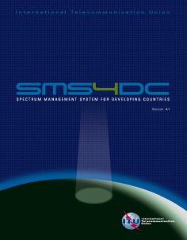
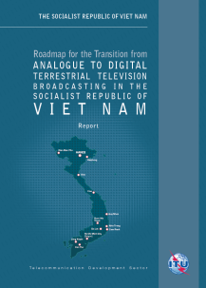
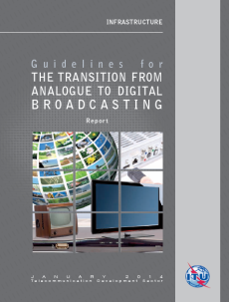
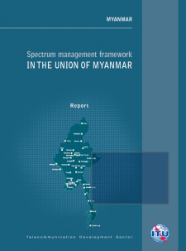

Spectrum Management and Broadcasting
      Spectrum Management Tool (SMS4DC)
      A computer program to assist the administrations of developing countries
      On technical and regulatory procedures for managing spectrum
      around 50 subscribers
      National Roadmaps for Digital Broadcasting
      ITU has helped over 30 countries around the world since 2009 for establishing national goals, strategies, key activities and so forth
      The Guidelines for Digital Transition
      for the smooth transition to Digital Terrestrial Television Broadcasting (DTTB)
      On policy, technologies, network planning, customer awareness and business planning
      Worldwide revision published in 2014
      Direct assistance in spectrum management
      Assistance in Cross Border Frequency Coordination (HCM4A)
      Spectrum management assessment
      Establishment of spectrum master plans
      Spectrum monitoring
      Consulting to specific issues
      Other Activities of SBD
        DSO database on status of the transition to Digital Terrestrial TV Broadcasting
        Spectrum Management Training Program (SMTP)
        ITU-D Study Group Questions (Q8/1, Resolution 9, Q7/2)
        WSIS Action Lines (C3, C7 e-science, C9)

Slide 4
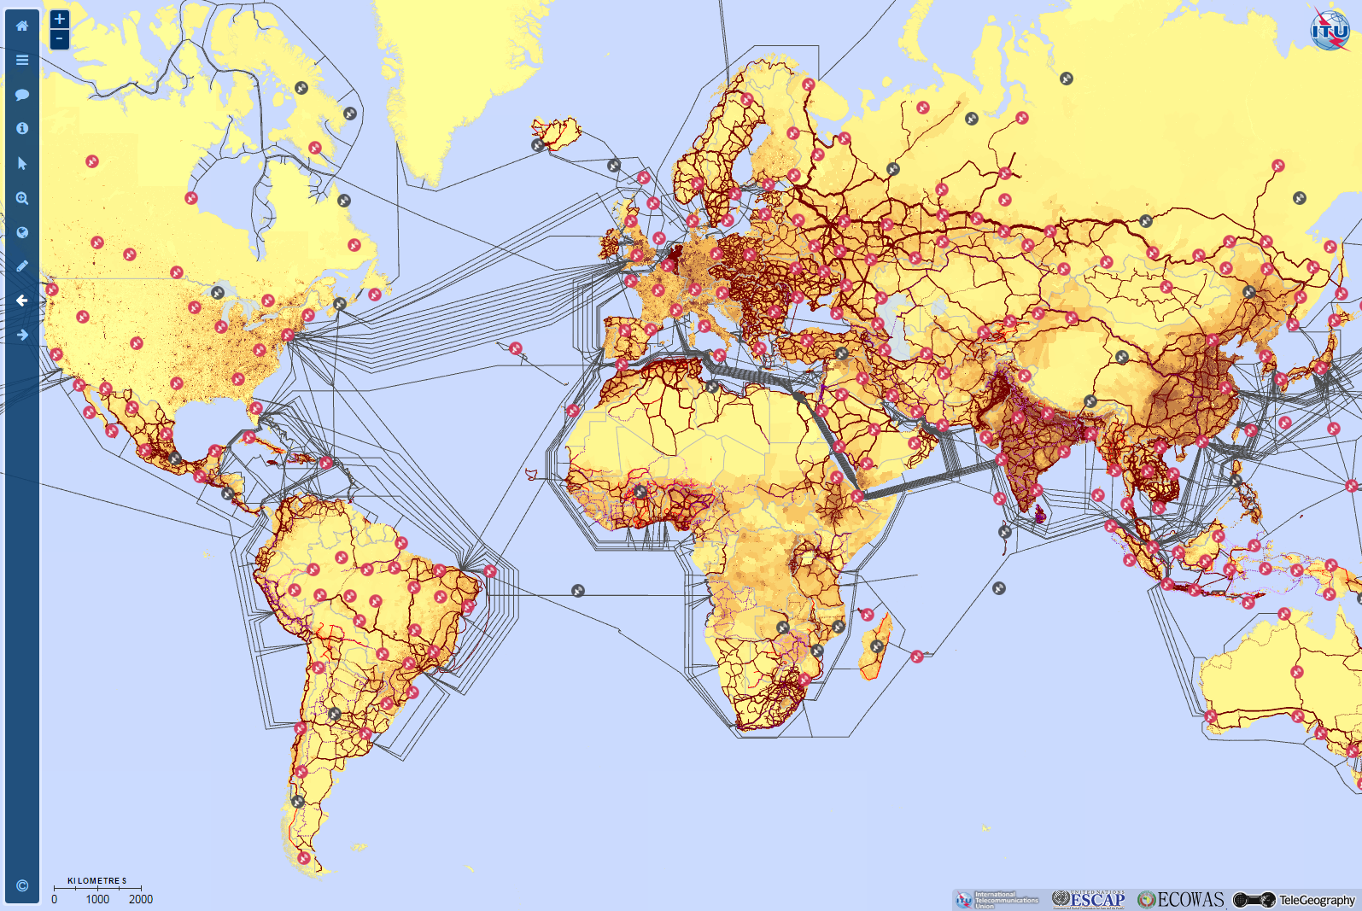
  ITU Interactive Transmission Maps
      The Interactive Transmission Maps are a cutting-edge ICT-data mapping platform to take stock of national backbone connectivity (Optical Fibres, Microwaves and Satellite Earth Stations) as well as of other key metrics of the ICT sector. Data concerning submarine cables are also included as provided by TeleGeography
        The Scope of this ITU project is to research, process and create maps of core transmission networks worldwide
The Objectives of this ITU project are:
to assess the status of national connectivity and to identify gaps enabling the design of targeted strategies and implementation programs for increasing the use of broadband.
to assess market opportunities, thus serving as a management tool for making investment decisions, promoting broadband and achieving universal connectivity.
to be used as a source of abundant and current data on global ICT connectivity.
http://itu.int/go/Maps

Slide 5
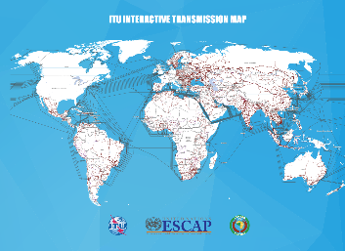
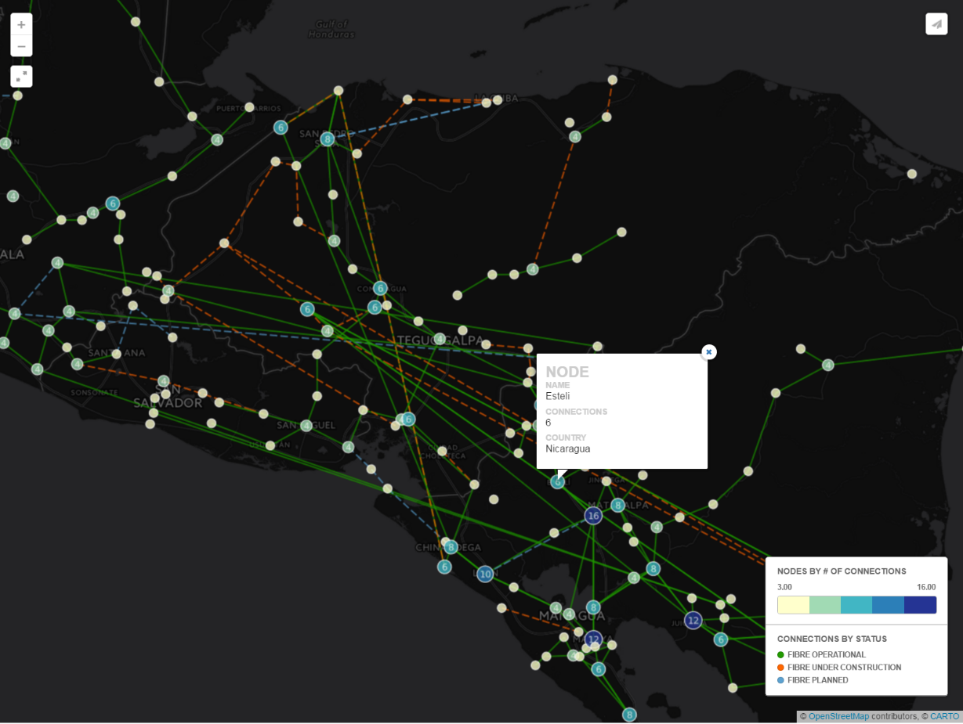
Broadband Infrastructure Network Planning
ITU is going to make use of the Maps together with data related to traffic exchanged between countries for identifying missing links on regional / subregional basis and developing case studies for Planning Broadband Infrastructures
Candidate Regions for 2018: North African and Asian-pacific countries
http://itu.int/go/Maps

Slide 6
Report on Implementation of Evolving ICT Infrastructure for Developing Countries
This input document to ITU-D Study Group 1 aims at presenting a comprehensive view of technical, economic and policy aspects in support of network key convergences.
It contemplates relevant international ITU standards for each topic covered: such as
Telecommunication/ICT Infrastructure: technology, economic and policy aspects
  Mobile and Fixed Broadband Access Networks
  Broadband Access for rural applications
  Core Networks
  Home Networks
  Network Operation and Management
  Economic and Policy Aspects
Link to the Report: http://www.itu.int/en/ITU-D/Technology/Documents/NGN/Report_on_Telecom-ICT_infra_20170117.pdf

Slide 7
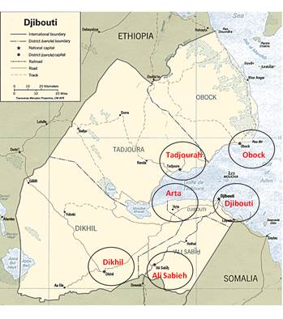
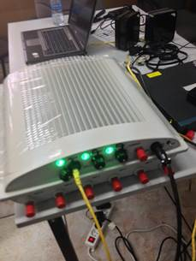
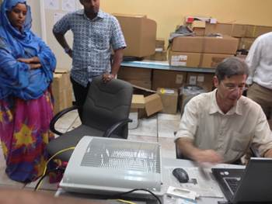
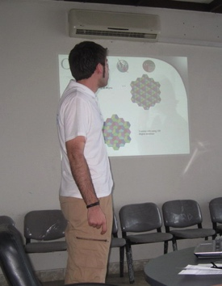
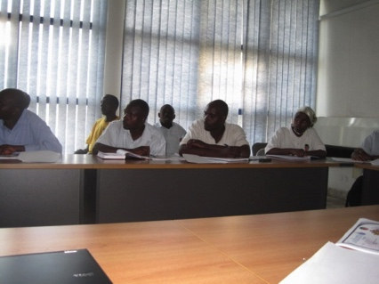
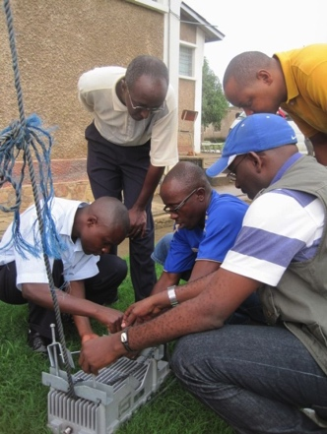
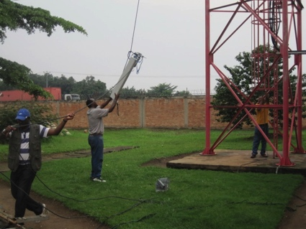
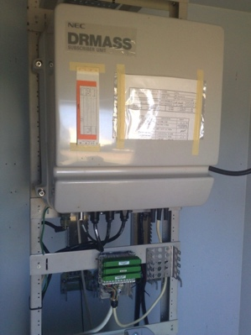
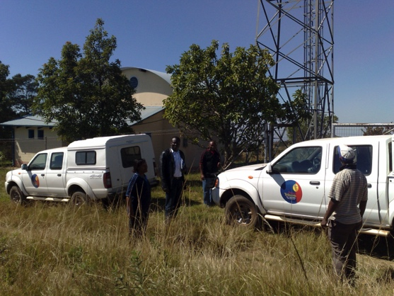
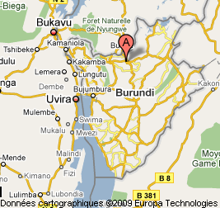
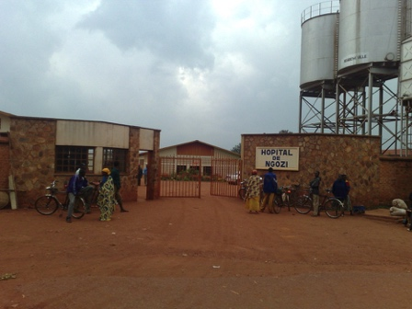
Djibouti - Mobile WiMax standard IEEE802.16e
Broadband Wireless Projects in Africa
Burundi Training & Network Installation
Swaziland Project Implementation - field Missions
Burundi - Connecting Hospitals for E-Health

Slide 8
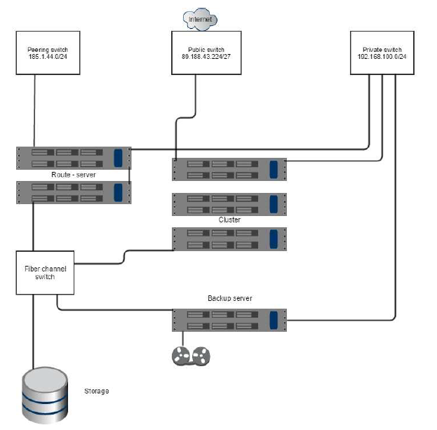
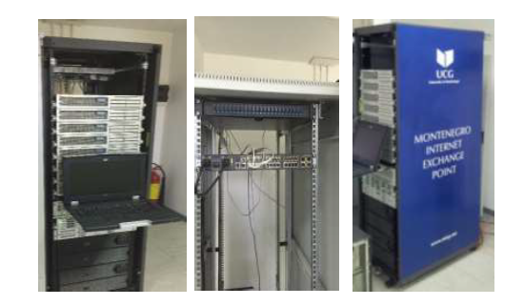
IXP In Montenegro
Implemented and operational since July 2015

Slide 9

Conformity and Interoperability

Slide 10
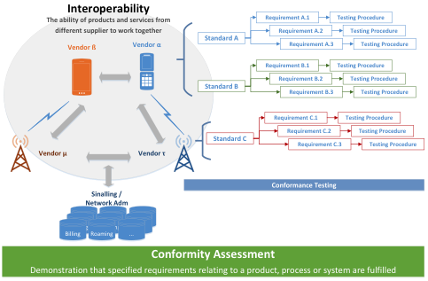
Conformity and Interoperability

Slide 11
ITU – C&I Programme
Pillars 3 (Capacity Building) and 4 (Assistance)

Slide 12
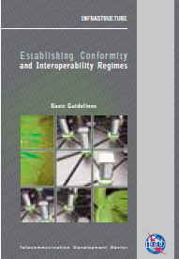
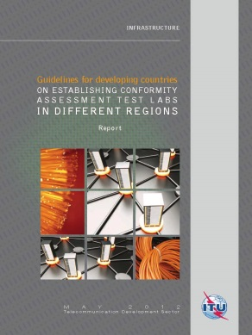
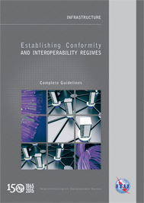
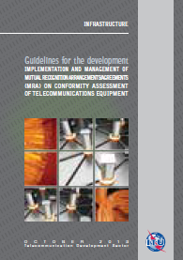
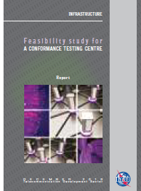
ITU C&I - Guidelines
Establishing Conformity and Interoperability Regimes – Basic Guidelines (2014) and Complete Guidelines (2015)
These Guidelines address challenges faced by developing countries as they plan and review their own C&I regimes. Aspects covered by this publication include, inter alia, conformity assessment procedures; legislation to promote an orderly equipment marketplace; surveillance; coordination across regulatory agencies; and relevant international standards.
Guidelines for developing
countries on Establishing Conformity assessment Test Labs in Different Regions (2012)
This set of guidelines is the first publication on C&I, its valuable content includes information concerning: The process required for building testing labs; A site analysis (e.g. existing testing labs, know-how);Collaboration mechanisms; Best practices; Reference standards and ITU Recommendations
Guidelines for the Development, Implementation and Management of Mutual Recognition Arrangements/Agreements on Conformity Assessment (2013)
These guidelines promote the understanding and establishment of Mutual Recognition Agreements (MRAs)
on conformity assessment that are intended to promote efficiency and resource sharing as well as to streamline the flow of products among participating Parties such as ITU Member States and private sector organizations, such as testing laboratories
Feasibility Study for the establishment of a Conformance Testing Centre (2013)
This feasibility study describes environments, procedures and methodologies to be adopted to establish, manage and maintain a testing center covering different kinds of conformance and interoperability testing areas
http://itu.int/go/CI_Guidelines

Slide 13
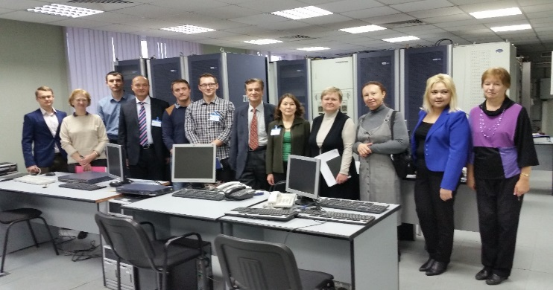
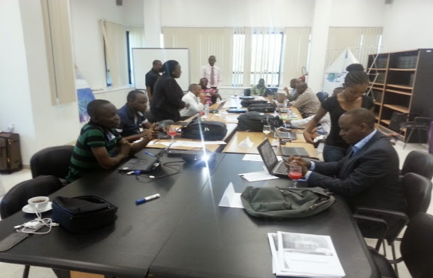
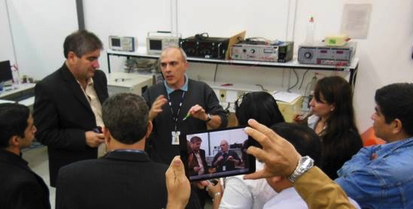
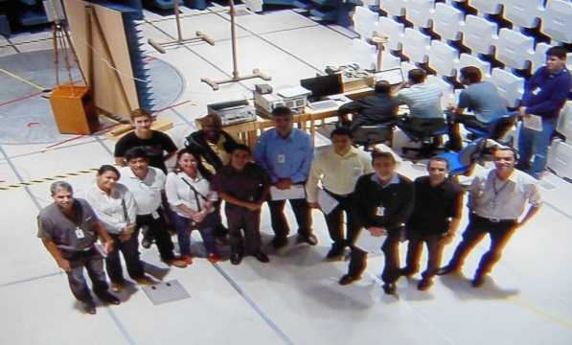
Conformity and Interoperability - Trainings
      ITU Trainings on Conformity an Interoperability
        MoUs signed with Testing Centers in the Regions to promote human capacity building in real testing laboratories
        Objectives: Enhance knowledge; increase awareness; promote experience-sharing, present practical learning on standards, regulations, real lab experience and accreditation procedures
        Lectures on C&I Regimes (e.g. Regulatory framework, market surveillance); and C&I Testing Domains (e.g. mobile, EMC, broadband, and NGN)

Slide 14
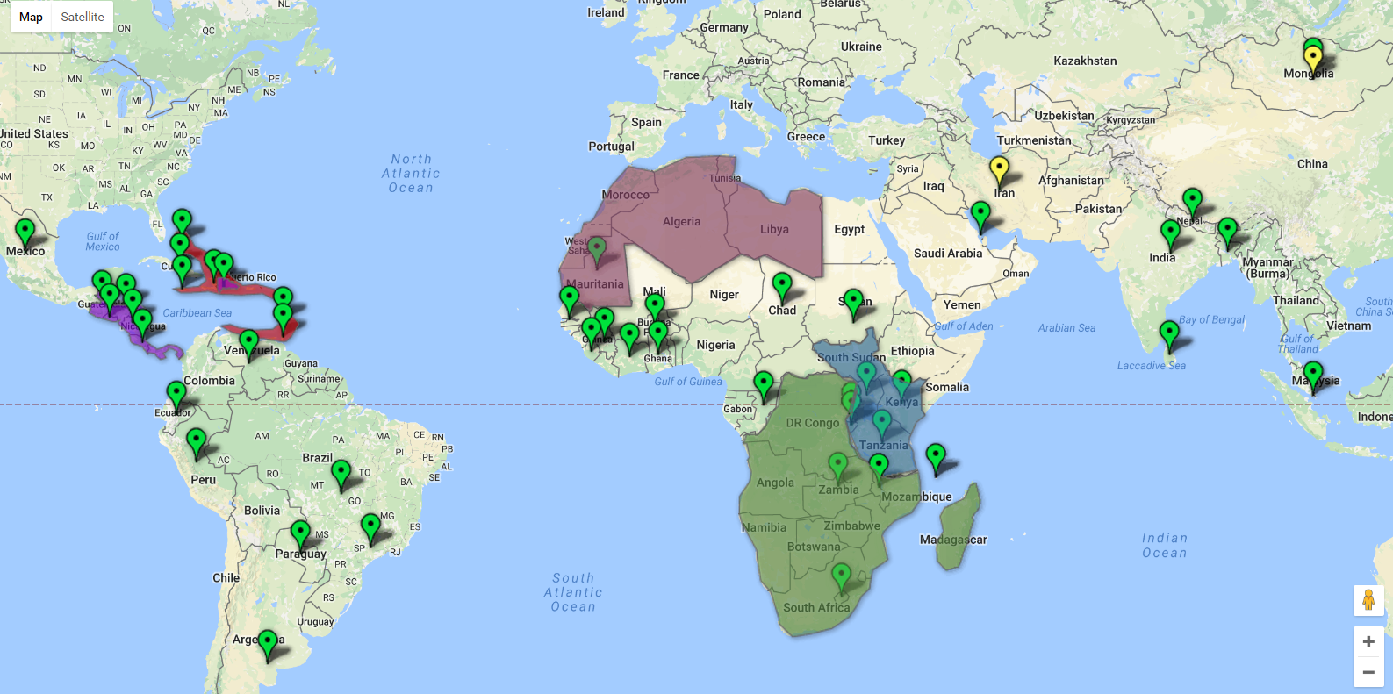
2016 C&I Activities Summary
In 2016, capacity building events were offered so far to 102 participants from 56 countries in real testing facilities through the collaboration of laboratory partners in the C&I Programme
5 Regions have received ITU C&I Assessment Studies
Assistance provided to countries on demand
More than 50 Case Studies/Country Reports are available through the ITU webpage (http://itu.int/go/CI_Development) and the ITU-D SG Case Study Library.

Slide 15
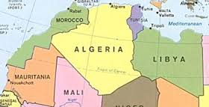
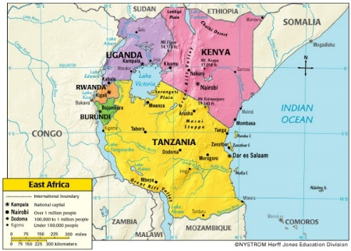
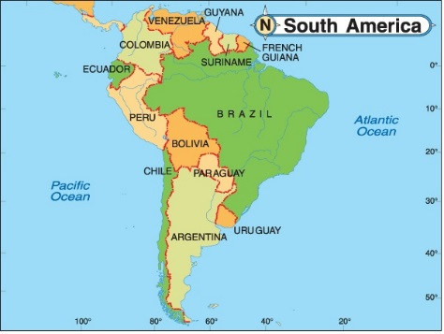
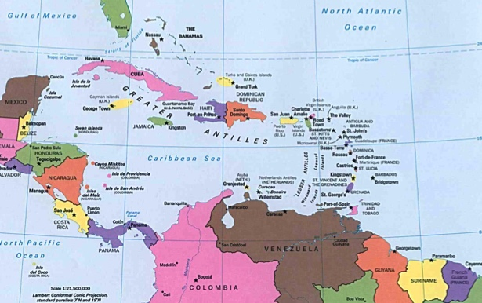
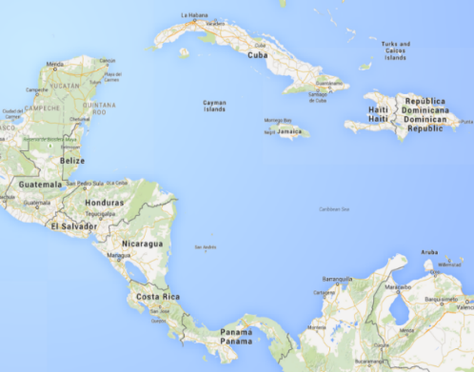
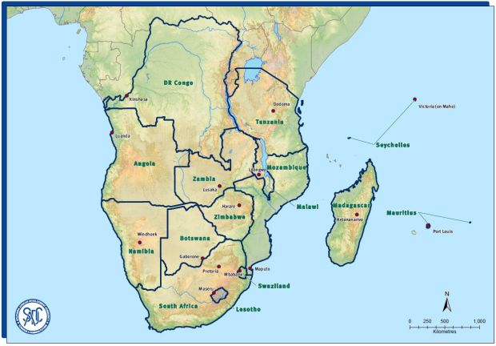
C&I Regional Assessement Studies
Activities and Goals
Assessemnt of C&I infrastructure in regions/sub-regions/countries are being assessed
Close collaboration with regional experts
Setup of a robust framework (base on international procedures – ITU, ISO, IAF, ILAC, etc.)
Introduction
C&I Assessment Studies looks for promoting the establishment of Harmonized C&I Programmes
Improve regional integration
Stimulating common standards
Sharing of C&I infrastructure
Search of innovative tools to be applied on the field
Maghreb (2015/2016)
EAC Countries (2015)
South America ((2017)
The Caribbean - CTU
(2014-2016-2017)
COMTELCA (2015/2016)
SADC Region (2014/2015)
http://itu.int/go/CI_Assessment_Studies
Notes:
Caribbean – 2017
feasibility study on the implementation of Conformance and Interoperability testing of telecommunication equipment within and/or between Caribbean states without national testing laboratories and operating under the CITEL Mutual Recognition Agreement
Key Tasks:
Produce the following deliverables:
A report on feasibility of implementing Conformance and Interoperability testing of telecommunication equipment within and/or between Caribbean states without national testing laboratories and operating under the CITEL Mutual Recognition Agreement.
A recommended workflow and procedures for the implementation of Conformance and Interoperability testing of telecommunication equipment within and and/or between Caribbean states without national testing laboratories and operating under the CITEL Mutual Recognition Agreement.
UMA 2016
Minutes of the Meeting
Recommendations and Action Plan
ToR of the UMA C&I Expert Group
Mutual Recognition Agreement (English - French)

Slide 16
Spectrum Management

Slide 17
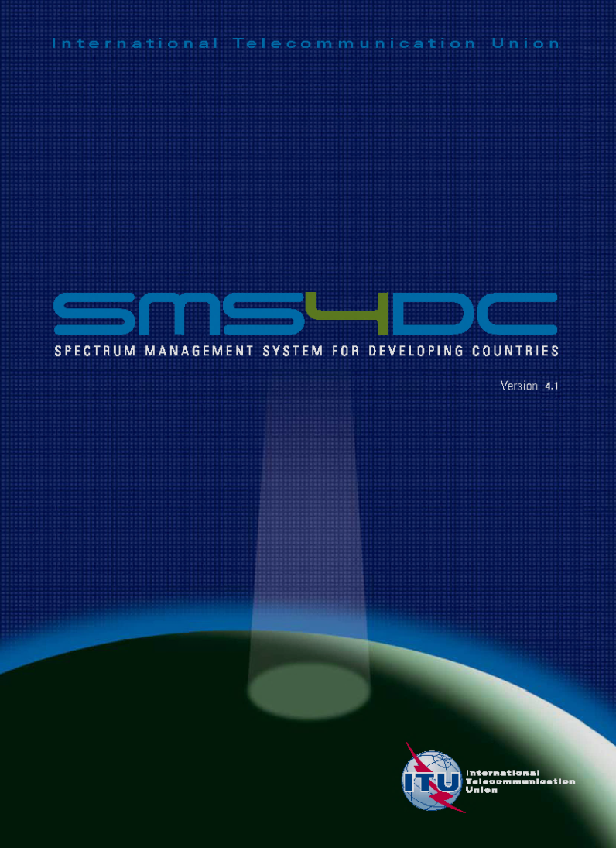
Spectrum Management Tool (SMS4DC)
A computer program to assist the administrations of developing countries
  On technical and regulatory procedures for managing spectrum
  A software package on CD containing a digital terrain map
Known as Spectrum Management System for Developing Countries
(SMS4DC)
  Made available in 2007, current version is 5.0
  Subscribers: around 50 countries

Slide 18
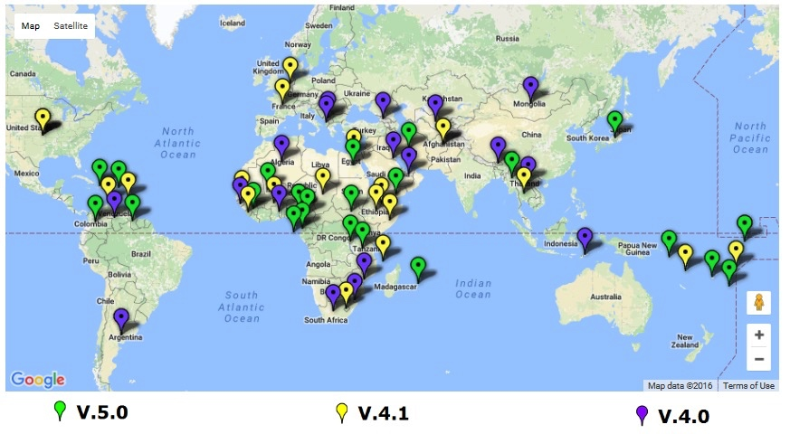
SMS4DC subscribers

Slide 19
  Cross Border Frequency Coordination
Harmonized Coordination Method for Africa (HCM4A)
  Set a standard on a mutually beneficial approach by consensus
  Provide a solid basis for bilateral and mutual agreements
  Oblige each country to take account of other stations
Implementation of HCM4A in four phases
  1. Assessment of existing administrative and technical procedures
  2. Multilateral agreement proposal by technical working group
  3. Validation workshop to adopt draft agreement
  4. Development of HCM4A software
HCM4A involves 4 sub regions
  Central, East, Southern and West Africa

Slide 20
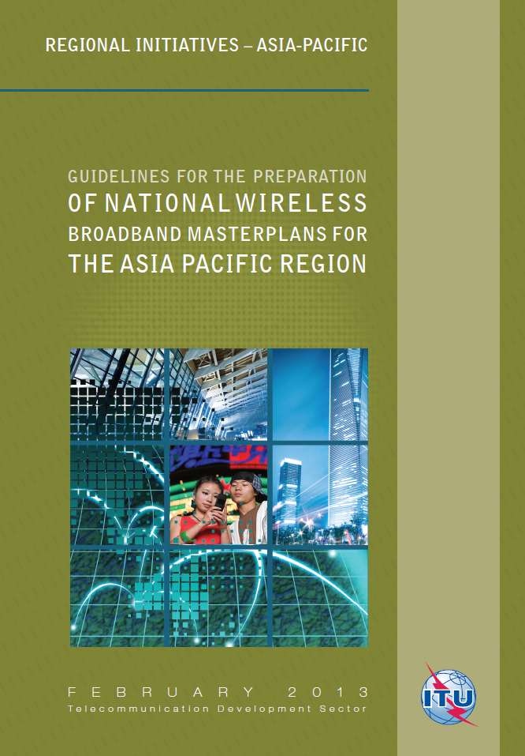
  Wireless Broadband Master plans & Broadband Policy
In order to facilitate wireless broadband development and implementation
  Assessment of existing policy and regulatory framework
  Recommendation on key policy issues including licensing, spectrum access, etc.
ITU has helped more than 20 countries since 2010
    Guidelines for ASP countries (2013)
    Wireless Broadband Master plan: 8 countries in ASP and Africa (2011~)
    National Broadband Policy: 12 countries in ASP and AMS (2012~)

Slide 21


Broadcasting

Slide 22
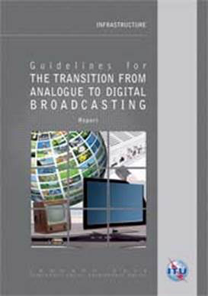
  The Guidelines for Transition to Digital Broadcasting
Intended to provide information and recommendation
  On policy, technologies, network planning, customer awareness and business planning
  for the smooth transition to Digital Terrestrial Television Broadcasting (DTTB) and introduction of Mobile Television Broadcasting
Prepared in 2010 for Africa
    1st Revision (2012) for ASP adding a section on archives migration
    2nd revision (2014) for global including Satellite TV, Cable TV, IPTV

Slide 23
  National Roadmaps for Digital Broadcasting
Assisted a number of Member countries in developing roadmap for transition from analogue to digital broadcasting
ITU has more than 40 countries since 2009 for establishing national goals, strategies, key activities and so forth
    Africa Region (6): Angola, Ethiopia, Mali, Gabon, DRC, Equatorial Guinea
    ASP Region (24): Afghanistan, Bangladesh, Bhutan, Cambodia, Fiji, Indonesia, Kiribati, Lao PDR, Maldives, Micronesia, Mongolia, Myanmar, Nauru, Nepal, Papua New Guinea, Philippines, Samoa, Solomon Islands, Sri Lanka, Thailand, Timor-Leste, Tonga, Vanuatu and Vietnam
    AMS (14): Guyana, 13 other
    Projects funded by Republic of Korea, Japan, Australia, CAF (Latin-American Development Bank)
    BDT direct assistance

Slide 24


Digital Terrestrial Television Broadcasting (DTTB)
DSO database
ITU/BDT

Slide 25
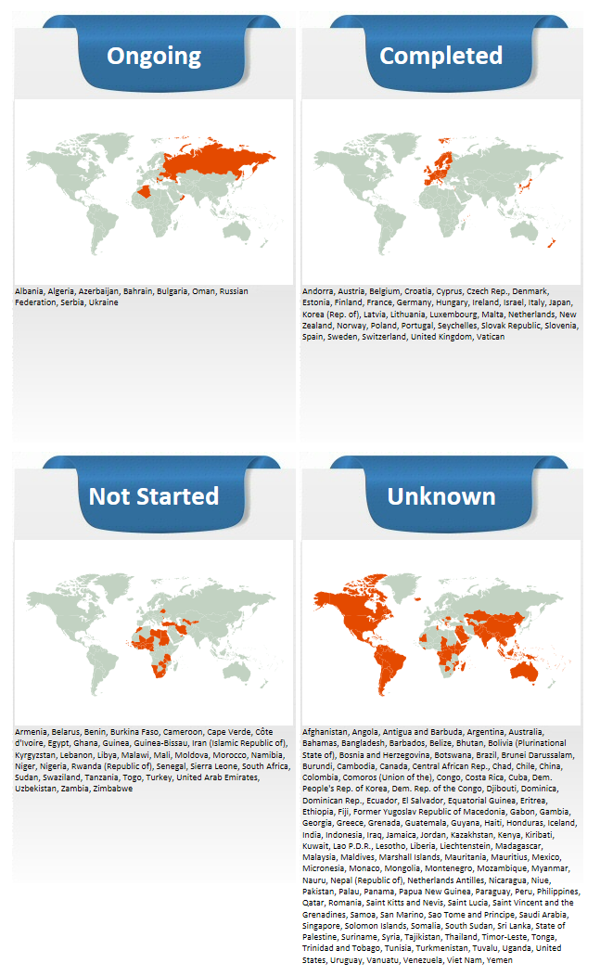
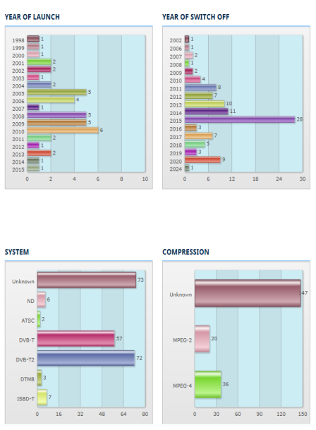
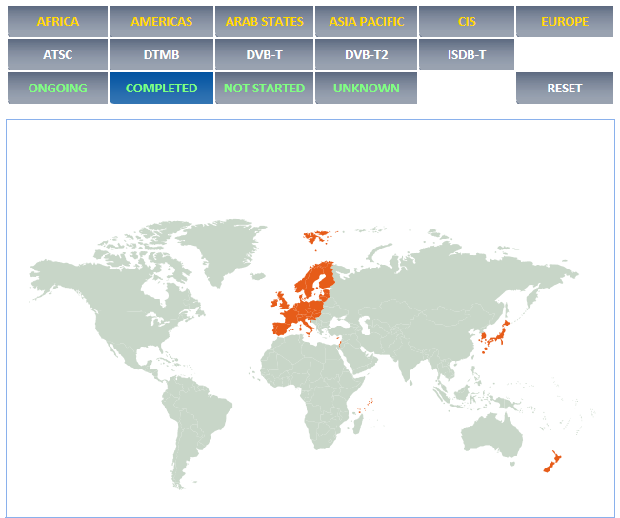
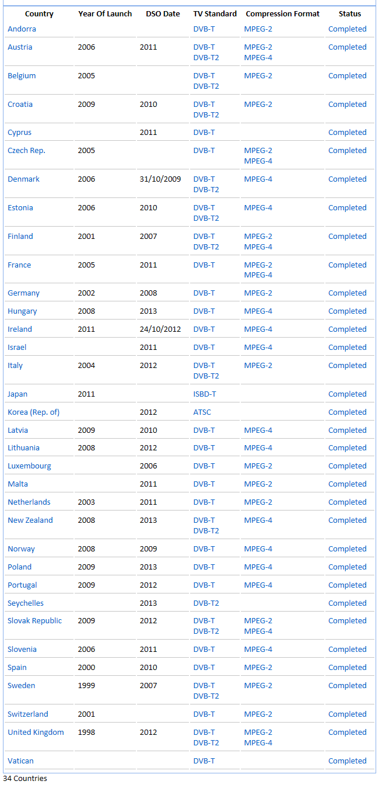
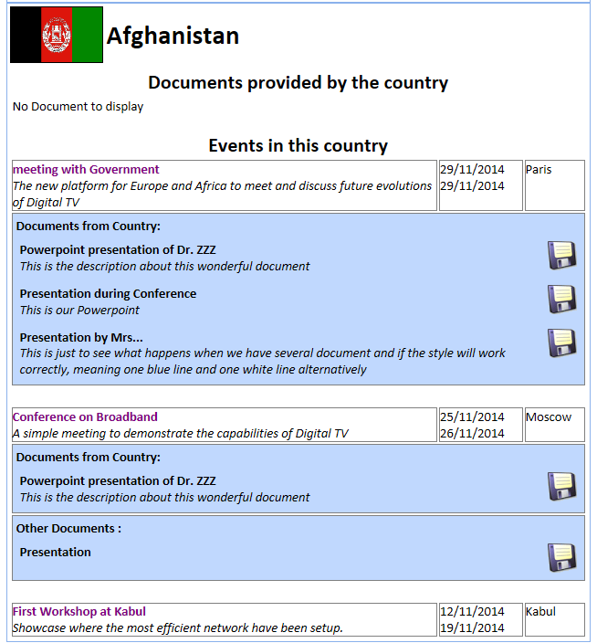
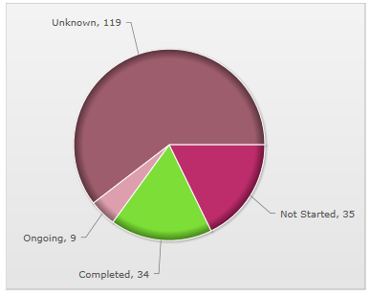
Website features
http://www.itu.int/en/ITU-D/Spectrum-Broadcasting/Pages/DSO/Default.aspx

Slide 26
Spectrum Management Training Program SMTP

Slide 27
Addressed problem
Today there are no formal holistic SM education programs, except some ad hoc commercial or public courses such as ITU BR seminars, USTTI
Large administrations train SM staff by seconding them to experienced workers, but this offers narrowed vision and no formal quality check
Many smaller administrations, especially in developing countries, do not have even such option, but must rely solely on ad hoc courses
Solution
ITU established Spectrum Management Training Program:
  Unified course, offering students across the globe access to state-of-the-art holistic SM training and forward-looking professional vision
  Formalised assessment ensuring minimal quality of professional education
  Certification to give international recognition, with possible option of university credits/diploma
Pilot
OM1 “Legal Basis and Regulatory Framework of Spectrum Management” – online, English, December 2014 – January 2015
  https://academy.itu.int

Slide 28
  Other Activities
Spectrum Management Area
    ITU-D Study Group 1 Resolution 9
    Offering information through publications
      “Guidelines for radio-frequency usage fees”, etc.
    Presentation at training seminars and workshops / assisting development of training program for spectrum management (SMTP)
    EMF related cooperation and activities ITU-D SG2 Question 7/2
Broadcasting Area
    ITU-D Study Group 1 Question 8/1
    Offering information to Member countries
      “Digital Dividend”, “Trends in Broadcasting”, “The Guidelines for Transition to Digital Broadcasting”, etc.
    Presentation at training seminars and workshops
    Cooperation with broadcasting organizations (WBU, EBU, ABU/AIBD etc.)

Slide 29
Spectrum Management and Broadcasting - summary
Spectrum management
  Spectrum Management Tool for Developing Countries (SMS4DC)
  Assistance in Cross Border Frequency Coordination (HCM4A)
  Spectrum Management Assessment, SM Master Plans
  Spectrum Management Training Program (SMTP)
Broadcasting
  Guidelines for Transition to Digital Broadcasting (E, F, S)
  Assistance for the preparation of national roadmap (more than 40 countries since 2009)
  DSO database

Slide 30


World Summit on the Information Society
ITU is the sole Facilitator of Action Lines C2 (Information and communication infrastructure)
Contributions to the WSIS Action Lines (C3, C7 e-science, C9)
WSIS Forum 2017
1. Monday Session, 12 June, 16:30-18:15 (http://www.itu.int/net4/wsis/forum/2017/Agenda/Session/372#intro):
  Title: Targeting SDG Goal 9: Identifying Development Gaps to Infrastructure Placement and Search for Opportunities
2. Thursday Session, 15 June, 16:30-18:15 (http://www.itu.int/net4/wsis/forum/2017/Agenda/Session/330#intro):
  Title: Action Line C2. Information and Communication Infrastructure: Building the Foundation for an Inclusive Information Society
8.2
1.4
9.1
9.a
11.5
9.c
11.b
SDGs

Slide 31







ITU-D Study Group Questions Related to TND
Question 1/1: Policy, regulatory and technical aspects of the migration from existing networks to broadband networks in developing countries, including next-generation networks, m-services, OTT services and the implementation of IPv6
Question 2/1: Broadband access technologies, including IMT, for developing countries
Question 5/1: Telecommunications/ICTs for rural and remote
Question 4/2: Assistance to developing countries for implementing conformance and interoperability programmes
  Question 8/1: Examination of strategies and methods of migration from analogue to digital terrestrial broadcasting and implementation of new services
  Resolution 9: Participation of countries, particularly developing countries, in spectrum management
  Question 7/2: Strategies and policies concerning human exposure to electromagnetic fields
https://www.itu.int/net4/ITU-D/CDS/sg/questions.asp?lg=1&sp=2014

Slide 32
Thank you
Vladimir Daigele
BDT/IEE/TND
Telecommunication Network and Spectrum Management Division
vladimir.daigele@itu.int
tnd@itu.int

